Slide 1

















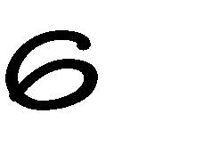

Slide 2

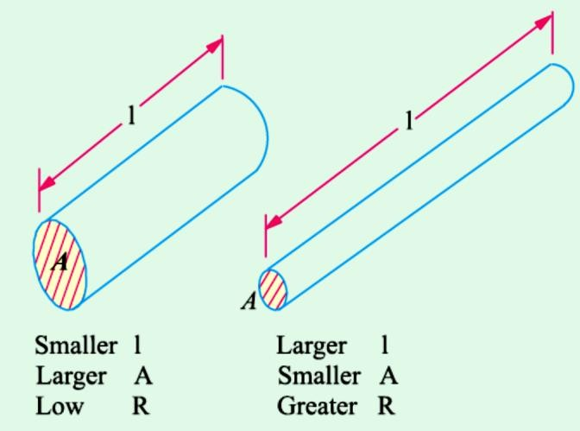

2-1 Resistance
It may be defined as the property of a substance due to which it opposes (or restricts) the flow of electricity (i.e., electrons) through it.
The unit of measurement of resistance is the ohm, for which the symbol
is Ω, the capital Greek letter omega. The resistance R offered by a conductor depends on the following factor:
It varies directly as its length, l.
It varies inversely as the cross-section A of the conductor.
It depends on the nature of the material.
It also depends on the temperature of the conductor. Neglecting the last factor for the time being, we can say that
Fig. 2-1 Resistor
2-2 Units of Resistivity
In the S.I. system of units,

Slide 3
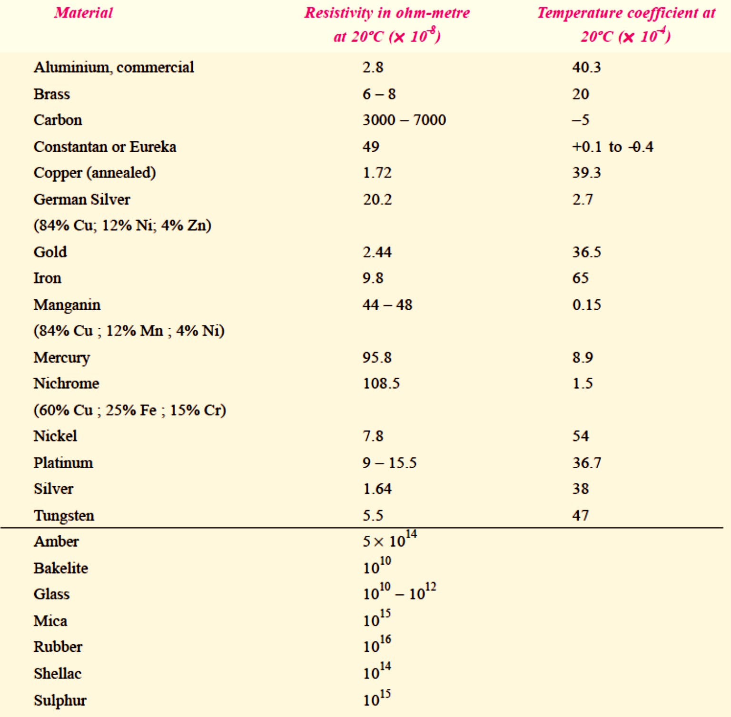
Hence, the unit of resistivity is ohm-metre (Ω-m).
It may, however, be noted that resistivity is sometimes expressed as so many ohm per m³. Although, it is incorrect to say so but it means the same thing as ohm-metre.
If l is in centimetres and A in cm², then ρ is in ohm-centimetre (Ω-cm). Values of resistivity and temperature coefficients for various materials
are given in Table 1.3.
The resistivities of commercial materials may differ by several per cent due to impurities etc.
Table 2-1

Slide 4
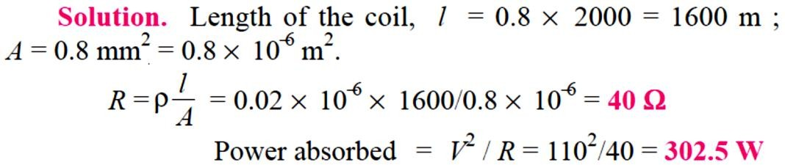
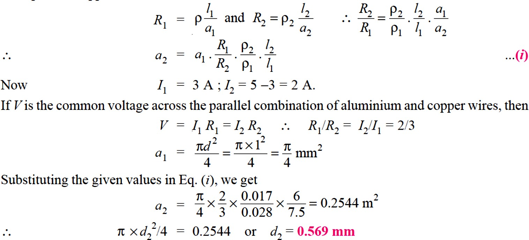
Example 1 / A coil consists of 2000 turns of copper wire having a cross- sectional area of 0.8 mm². The mean length per turn is 80 cm and the resistivity of copper is 0.02 μΩ–m. Find the resistance of the coil and power absorbed by the coil when connected across 110 V_{d.c}. supply.
Example 2 / An aluminium wire 7.5 m long is connected in a parallel with a copper wire 6 m long. When a current of 5 A is passed through the combination, it is found that the current in the aluminium wire is 3
A. The diameter of the aluminium wire is 1 mm. Determine the diameter of the copper wire. Resistivity of copper is 0.017 μΩ-m ; that of the aluminium is 0.028 μΩ-m.
Solution:
Let the subscript 1 represent aluminium and subscript 2 represent copper.

Slide 5
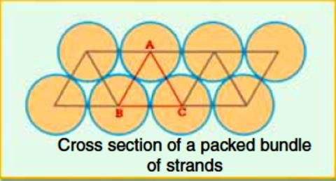
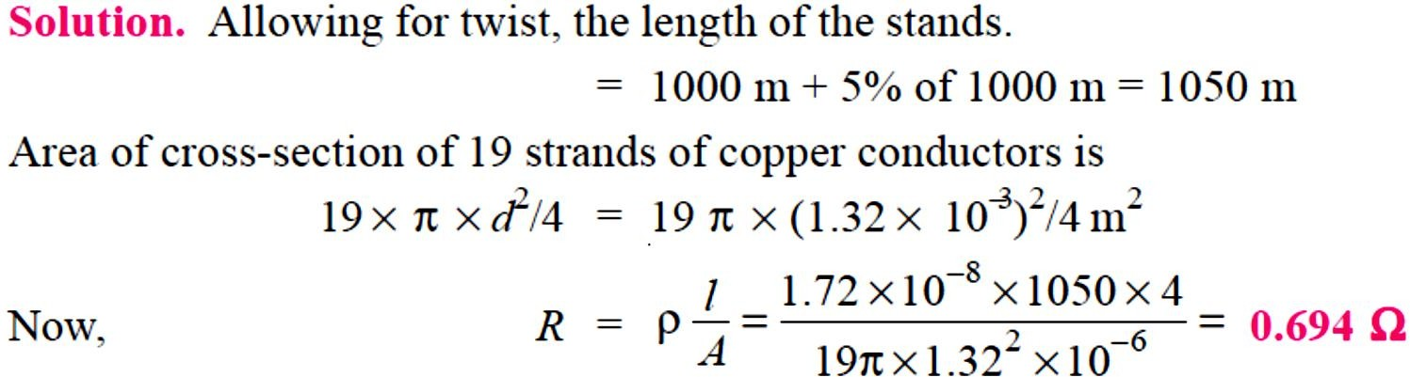
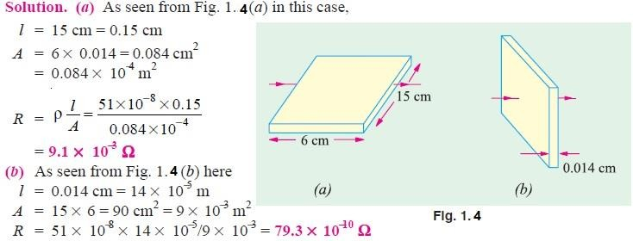
Example 3 / Calculate the resistance of 1 km long cable composed of 19 strands of similar copper conductors, each strand being 1.32 mm in diameter. Allow 5% increase in length for the ‘lay’ (twist) of each strand in completed cable. Resistivity of copper may be taken as 1.72 × 10−8 Ω m.
Example 4 / The resistivity of a ferric-chromium-aluminium alloy is 51
× 10⁻⁸ Ω-m. A sheet of the material is 15 cm long, 6 cm wide and 0.014 cm thick. Determine resistance between (a) opposite ends and (b) opposite sides

Slide 6
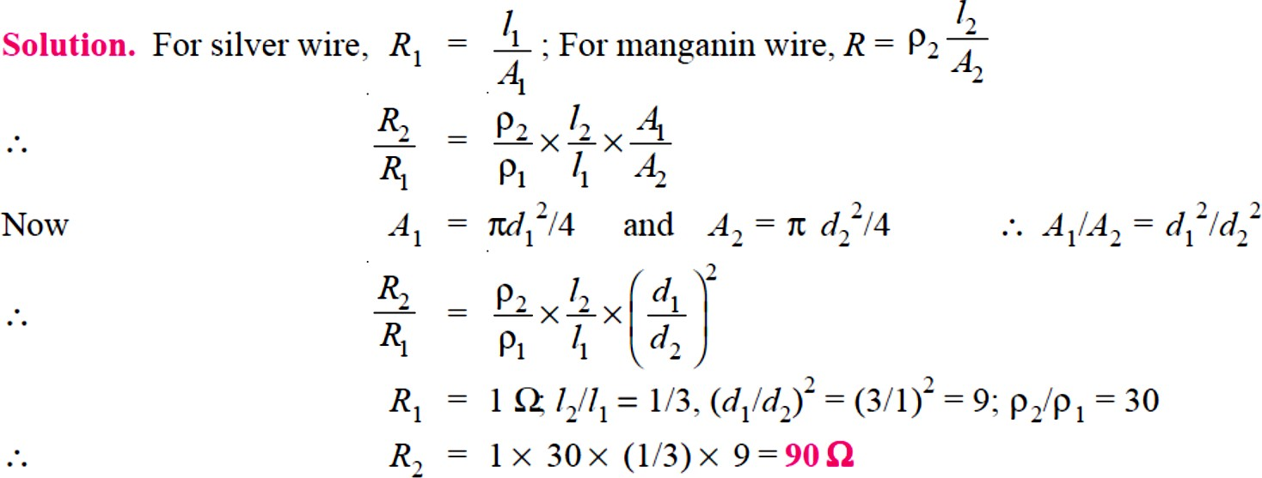
Example 5 / A piece of silver wire has a resistance of 1 Ω. What will be the resistance of manganin wire of one-third the length and one-third the diameter, if the specific resistance of manganin is 30 times that of silver.
H.W. 1
A cube of a material of side 1 cm has a resistance of 0.001 Ω between its opposite faces. If the same volume of the material has a length of 8 cm and a uniform cross-section, what will be the resistance of this length?
Answer: 0.064 Ω
H.W. 2
A rectangular metal strip has the following dimensions : x = 10 cm, y =
0.5 cm, z = 0.2 cm
Determine the ratio of resistances R_{x}, R_{y}, and R_{z} between the respective pairs of opposite faces.
Answer: [Rx : Ry : Rz :10000 : 25 : 4]

